Slide 1
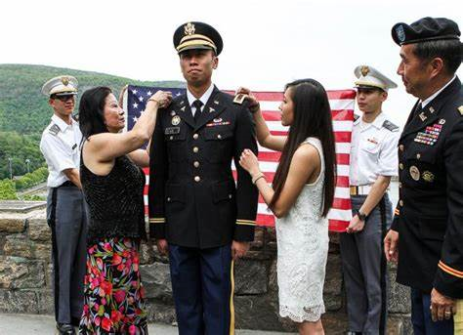
CCMR and the US ARMY

Slide 2
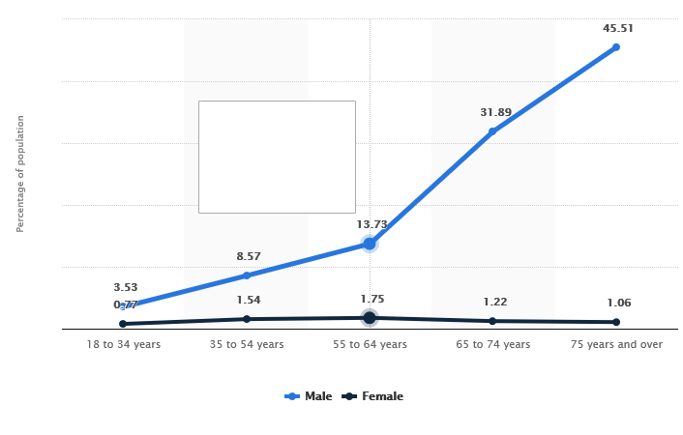
CCMR and the US ARMY

Slide 3
CCMR and the US ARMY
COLLEGE
Post 9/11 GI Bill Texas Hazelwood Act
Tuition Assistance Program
The Federal Perkins Loan Cancellation Program
The Student Loan Repayment Program (LRP)
The Concurrent Admissions Program (ConAP)
The Military Spouse Education And Career Opportunities (SECO)
The Minuteman Scholarship
Army Medicine Scholarships
Funded Legal Education Program (FLEP)

Slide 4
CCMR and the US ARMY

Slide 5
CCMR and the US ARMY
CAREER
Active Duty
Full Time Job
Pay/Benefits
Travel the World
3 – 6 Year Contracts
Army Reserves
Part Time Job
Pay/Benefits
Stay in your hometown
Keep your current job
Go to school now
1 weekend a month
2 weeks Active
6 Year Contract

Slide 6
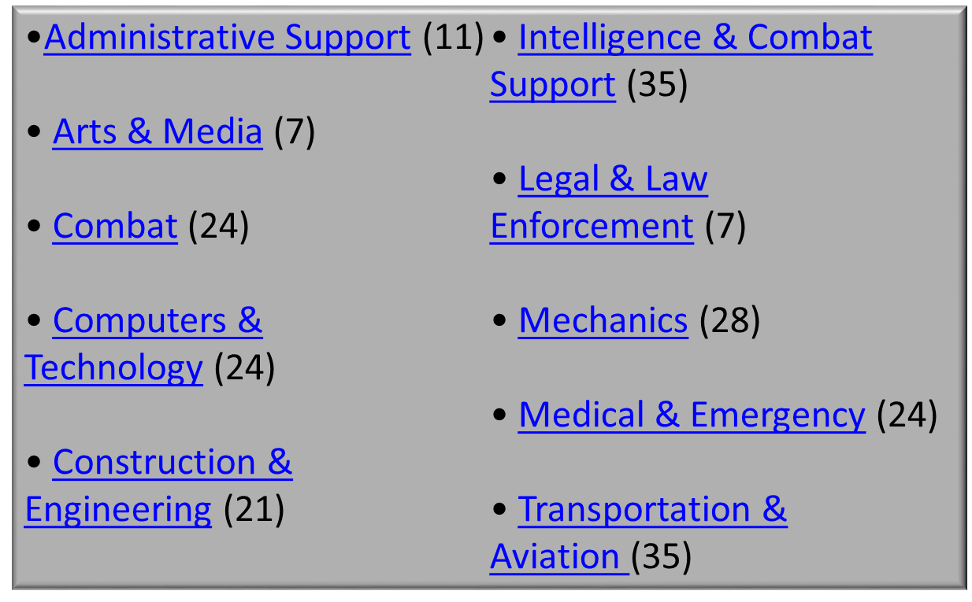
CCMR and the US ARMY
CAREER

Slide 7
CCMR and the US ARMY
MILITARY READINESS
ASVAB-CEP
MULTIPLE-APTITUDE TEST
The ASVAB assesses a student’s ability to learn new skills and is a predictor of success in training and education programs. It covers areas including science, word knowledge, mathematics, and mechanical comprehension.
INTEREST INVENTORY
REALISTIC
INVESTIGATIVE
ARTISTIC
SOCIAL
ENTERPRISING
CONVENTIONAL
STUDENT INTENTIONS
Five-year average
46% 4 year college 24% Undecided
17% Military 8% 2 year college
3% Work 2% Vo-Tech

Slide 8
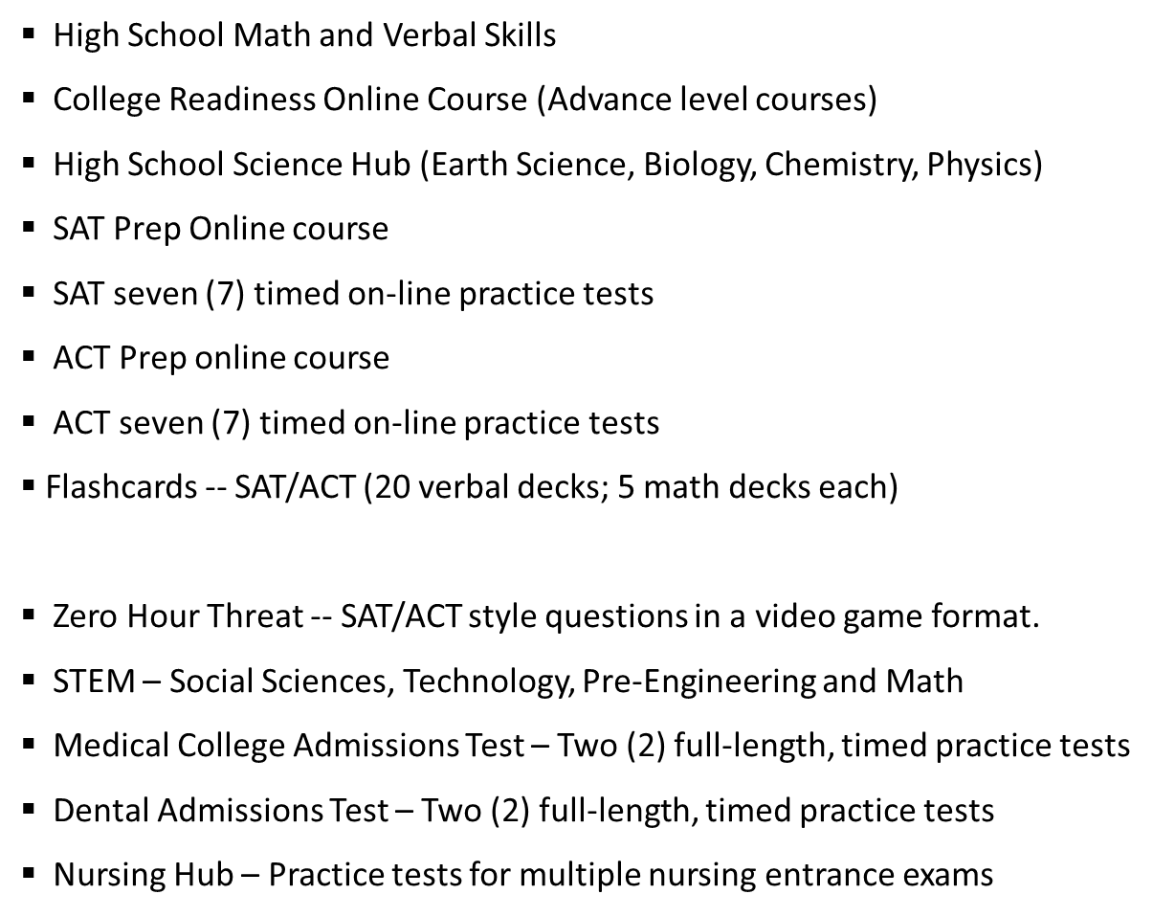
CCMR and the US ARMY
MILITARY READINESS
MARCH2SUCCESS.COM

Slide 9
CCMR and the US ARMY
HB3
WAY FORWARD
Increased Visibility
Present Army Opportunities and Benefits at Faculty and Staff Meetings
Classroom Presentations
Core Classes (Juniors/Seniors)
CTE Classes
Presentation Opportunities at Parent FAFSA Nights
Presentation Opportunities at Career Day Events
Military Post Visit (1 Day Trip to JBSA)

Slide 10
CCMR and the US ARMY
QUESTIONS??

